Slide 1

Power Generation in USA

Slide 2
The EIA-923 Schedule 2, Part A provides data related to fuel generation and importation for our analysis. This data includes information on the types of fuel generated or imported the quantities of fuel. The locations of generation or importation and the companies involved in the generation or importation.
This information can be used to analyze trends in fuel generation and importation over time, as well as to identify patterns and insights related to the use of different types of fuel in various regions.
Based on the observations, it appears that a significant amount of fuel is being imported, and the prices of fuel are not always in proportion to market conditions in the United States.
This is a concern because the US economy is generally considered stable, and it is important to take economic stability into account when analyzing fuel prices.

Slide 3
The given file is clear of duplicate information, and all missing values have been replaced with null values, so there are no missing values. As a result, the data is considered as clean and prepared for analysis.
The findings give a precise and comprehensive representation of the fuel's place of origin by emphasizing the many regions where it is produced or imported.
To make the data simpler to understand in smaller, more manageable samples, we will now divide the data into smaller samples.

Slide 4
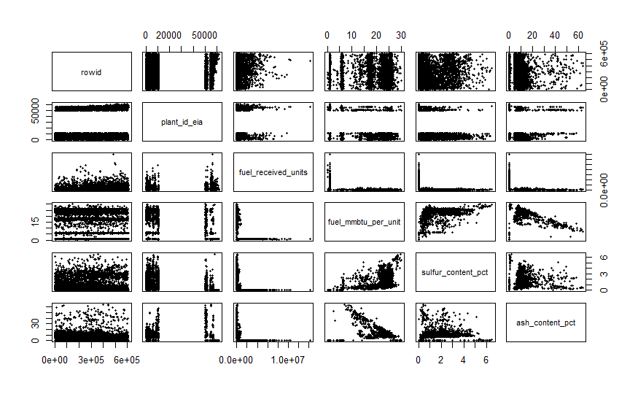
Upon analyzing the ratio of fuel imports and usage, I noticed that there is some inconsistency or variation in the numerical data.
Based on my observations, the ash content has played a significant role in the formation of clusters in the data.
However since a considerable portion of the data is categorical, a theoretical analysis was done to explore the impact it has on the environment. Additionally, my findings suggest that the import and export of fuel also play a significant role in the data.

Slide 5
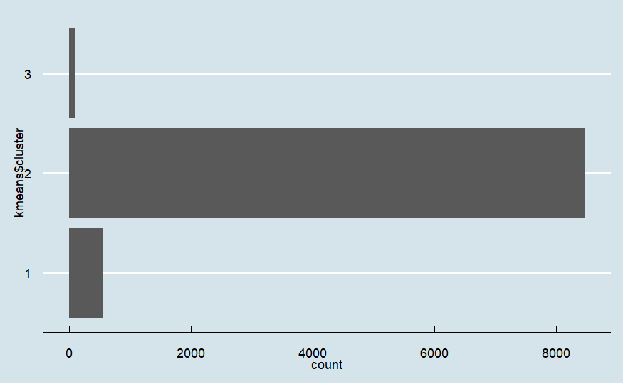
I performed an analysis on the information pertaining to the fuel's ash content as measured in million British Thermal Units. After a sample of furnace oil has burned completely, there is a residual, non-combustible component called ash content that is still present.
When a fuel has a high ash content, it means that the fuel's specific quantity has a comparatively little amount of volatile materials.
Ash content was the metric with the highest value among those measured, while sulfur and mercury had the lowest values.
Based on the variations in the ash content present in each cluster, my study shows that the data may be separated into three different clusters.

Slide 6

Conclusion :
The need for components generated from petrochemicals in the manufacture of renewable energy systems, such as solar panels, wind turbines, and batteries, emphasizes the connection between fossil fuels and renewable energy.
Managing energy use entails not only locating alternative energy sources but also making an effort to cut back on consumption to lower expenses for the nation and lessen the damaging effects of fuel use on the environment.

